Slide 1
Phase 3 Phonics Workshop

Slide 2
Phase 3 Letters and Sounds
What vocabulary will my child be using during lessons?
Phoneme - The smallest unit of sound. There are approximately 44 phonemes in English (it depends on different accents). Phonemes can be put together to make words.
Grapheme - A way of writing down a phoneme. Graphemes can be made up from 1 letter e.g. p, 2 letters e.g. sh, 3 letters e.g. tch or 4 letters e.g ough.
Digraph - A grapheme containing two letters that makes just one sound (phoneme).
Trigraph - A grapheme containing three letters that makes just one sound (phoneme)

Slide 3
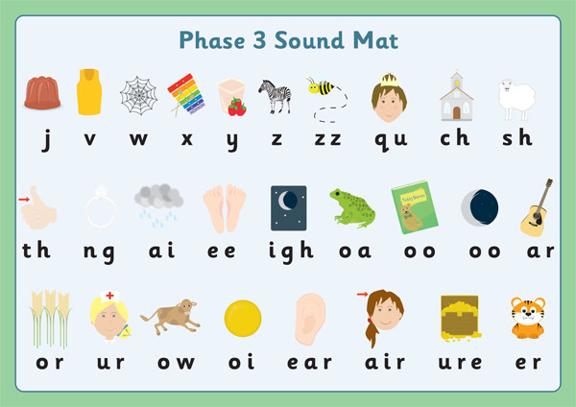
How will my child pronounce the Phase 3 Phonics Sounds?

Slide 4
How will my child read a word with diagraphs?
sheep

Slide 5
How will my child read a word with a trigraph?
night

Slide 6
How can I support my child when reading a phase 3 caption?
Point out the tricky words
I am in such a rush to get to the shops.
Add sound buttons to words if needed

Slide 7
What ‘tricky words’ will my child learn on sight?
he | she | we | be | was | her
you | they | all | are | my

