Slide 1
Phonics Phase 2
Belton Lane Community Primary School

Slide 2
What is Phonics?
Phonics is recommended as the first strategy that children should be taught in helping them learn to read.
It helps children hear, identify and use different sounds that distinguish one word from another in the English language.
We teach phonics daily, (sometimes twice daily!), and we listen to your child read from their sound book once a week. All children also partake in a weekly phonics adult led activity appropriate to their ability.

Slide 3
Useful Vocabulary
Phoneme- the smallest identifiable sound e.g the letters ‘sh’ represent just one sound, but ‘sp’ represents two (/s/ and /p/).
Diagraph- two letters making one sound, e.g sh, ch, th, ph.
Blend (vb)- to draw individual sounds together to pronounce a word, e.g s-n-a-p, blended together, reads snap.
Segment (vb)- to split up a word into its individual phoneme in order to spell it, e.g the word ‘cat’ has three phonemes /c/ /a/ /t/.

Slide 4
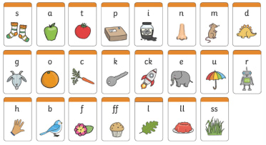
What is Phase 2 Phonics?
We start our learning of Phonics in reception on Phase 2, which comprises of:
As soon as each set of letters is introduced, children will be encouraged to use their knowledge of the letter sounds to blend and sound out words. For example, they will learn to blend the sounds s-a-t to make the word sat. They will also start learning to segment words.

Slide 5
Initial and End Sounds
When children learn how to blend and segment they need to listen carefully for the initial and end sounds in words.
For example, dog
initial
end

Slide 6
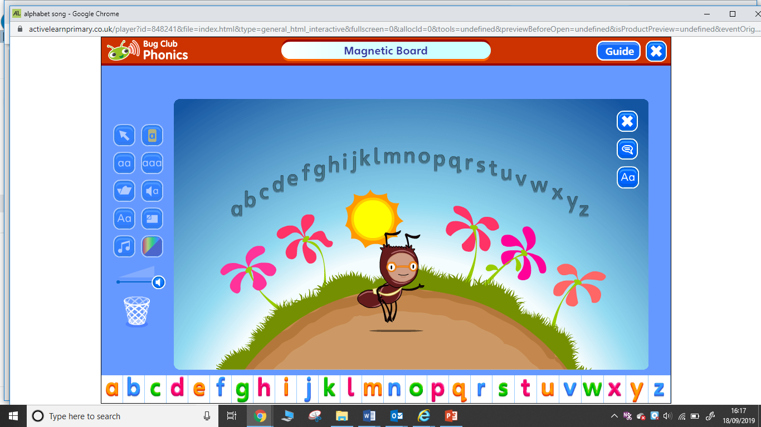
Phonics Bug
To teach phonics we use a programme called phonics bug. Each lesson begins and ends with the alphabet song to ensure that children at not only learning the sounds of letters but also the letter names.

Slide 7
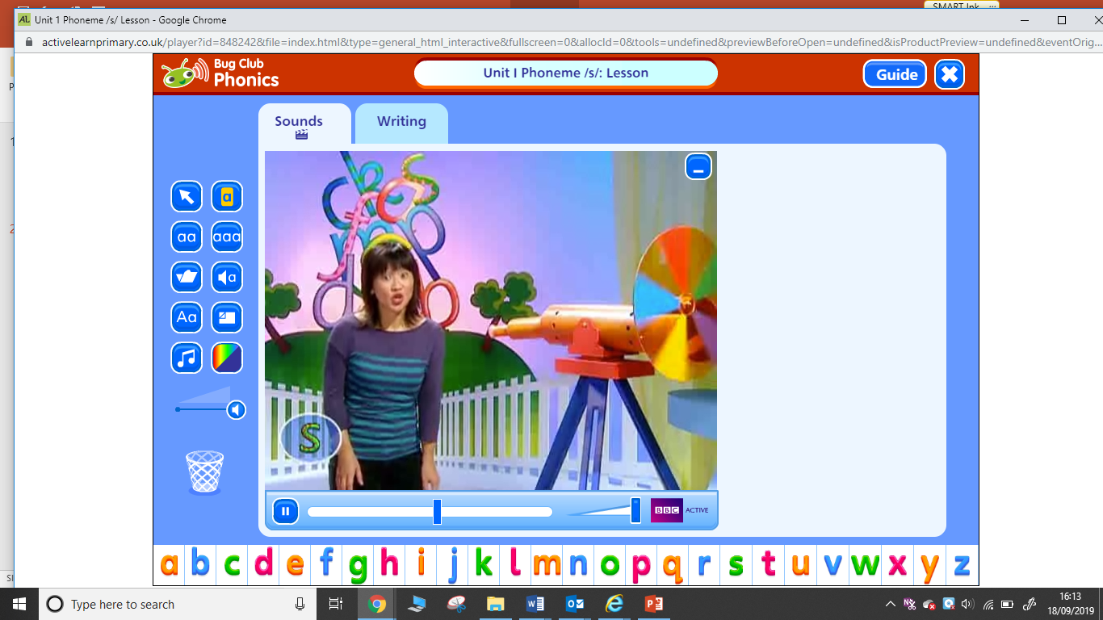
Phonics Bug
Phonics bug uses interesting and exciting videos to grab the children’s attention. The children love to join in by saying what they see. This encourages recognises initial and end sounds.

Slide 8
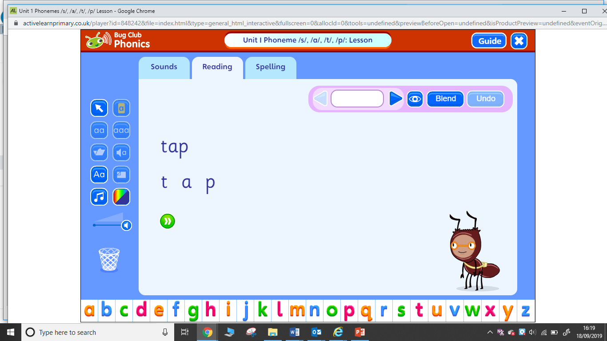
Phonics Bug
Once the children have learnt the first few sounds we will begin to sound out using our phonics hands.

Slide 9
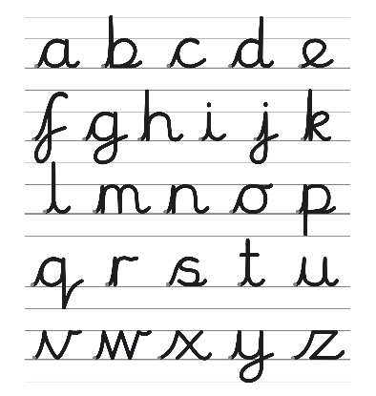
Learning to write
This year we are going to teach the children to write using cursive handwriting. This will enable the children to join their letters at an earlier point in Year One. All letter begin from the bottom of the line so children cannot get mixed up on where to start, this will also help with letter formation.
We will be using a programme called ‘letter join’ that has similar videos to Phonics Bug.

Slide 10
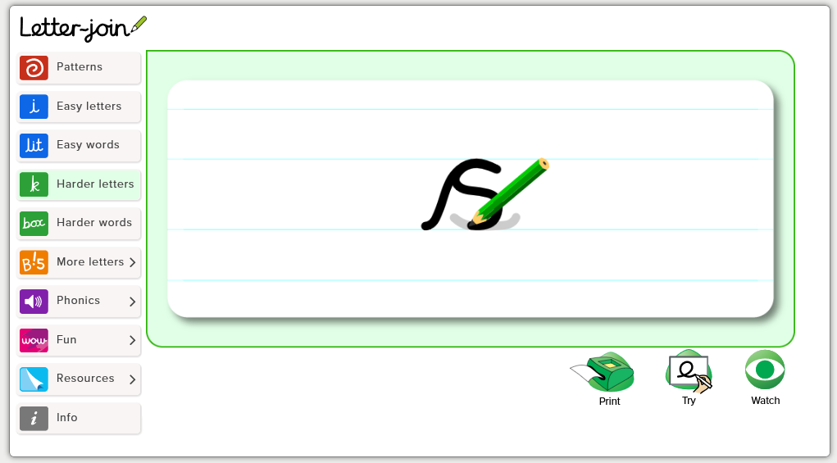
Using letterjoin

Slide 11
How can I help my child at home?
Each child will have a Phase 2 sound book that teachers will use on a weakly basis to asses progress.
Spend a few minutes a day looking at the sounds that we have learnt so far (these will be on the weekly round up).

Slide 12
How can I help my child at home?
Each child will have a paperback reading book in their reading folder.
Make a quiet space with no distractions- espically the TV!
Start by looking at the images; what can your child predict about what the book may be about?
tell them the title; do they understand what the words of the title mean?; does the title coincide with your child’s prediction of what the book will be about?
Be enthusiastic!

Slide 13
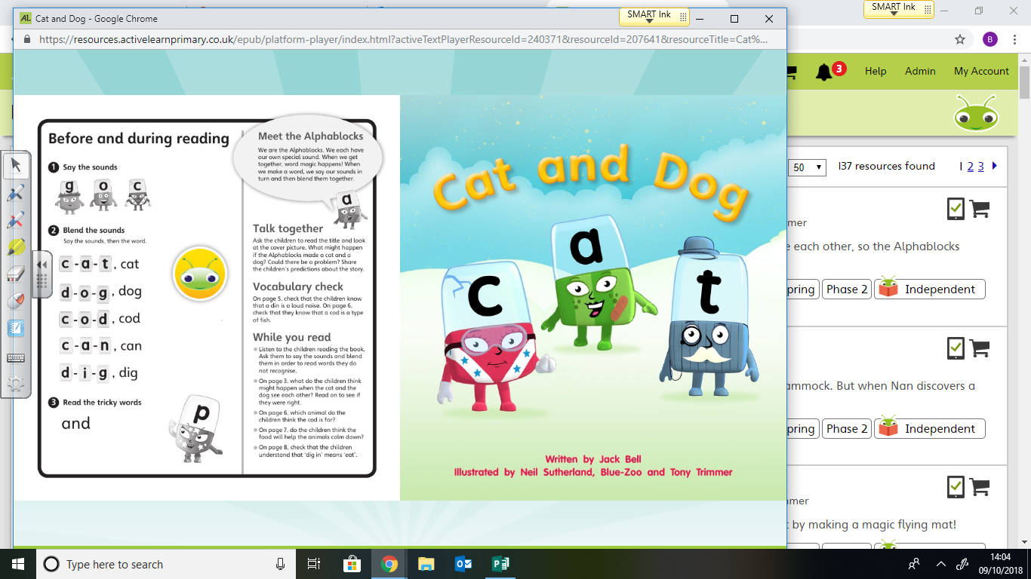

Slide 14
Sounding out and Blending with you child.
When reading the book:
With your child support them sounding out and blending the words there (you might need to sound it out for them and then they copy, pointing to each sound as you say it)
TOP TIP: re-read each sentence as you sound it out for the child.

Slide 15

Have a go yourself
Stop! can not kip.

Slide 16
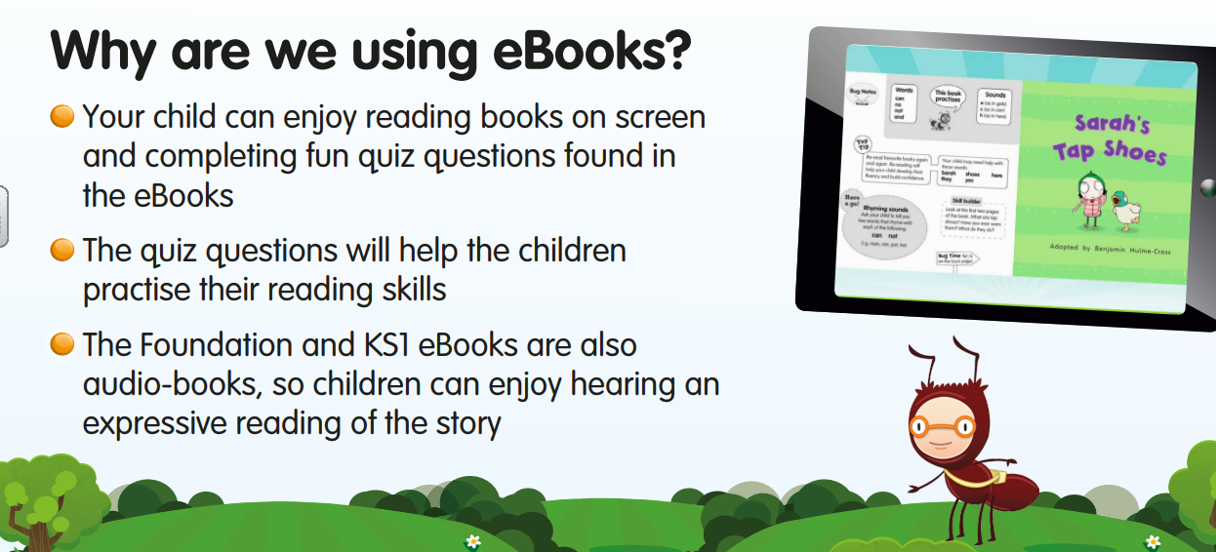

Slide 17
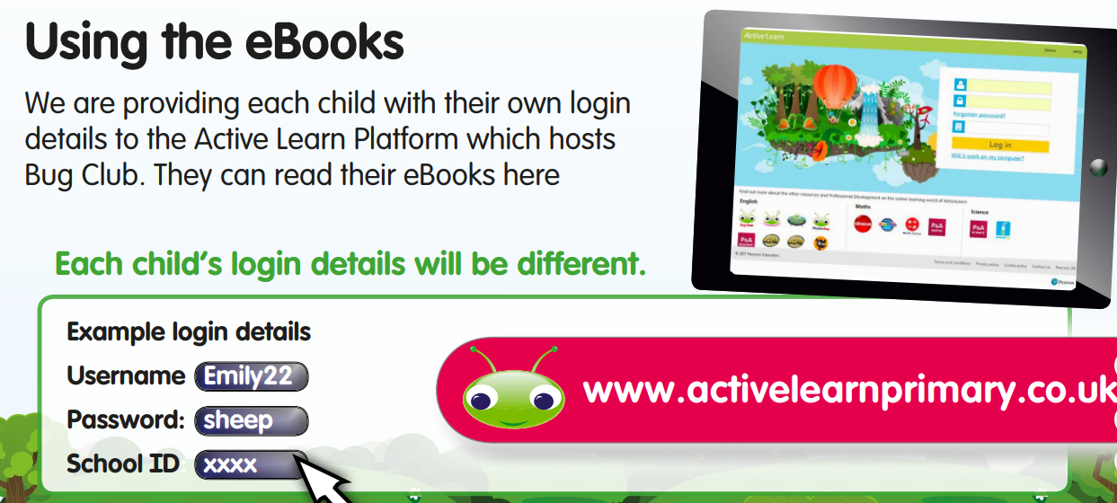

Slide 18
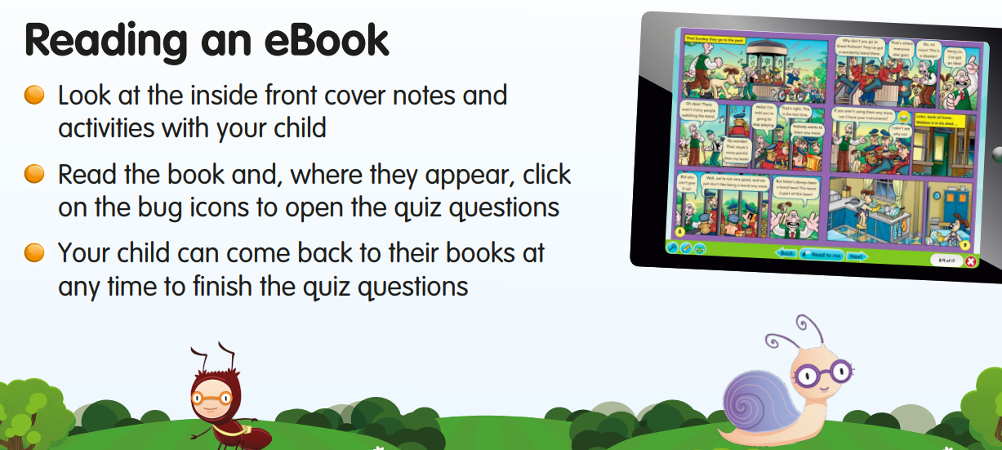

Slide 19
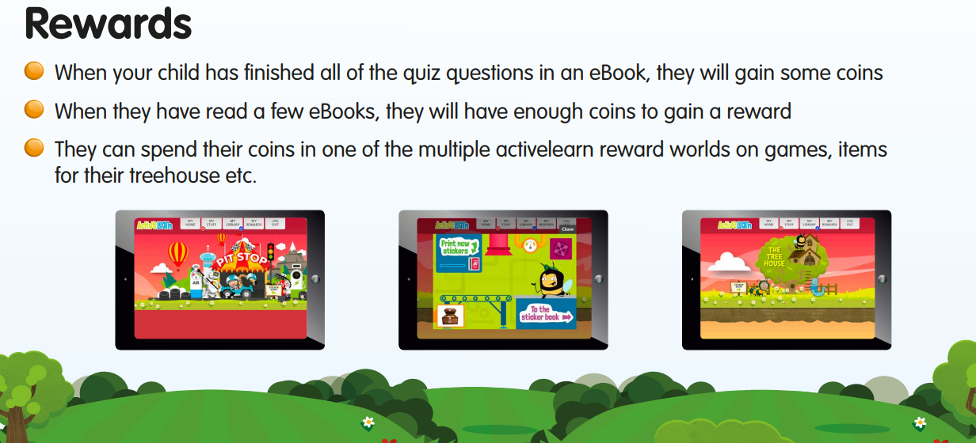

Slide 20
When should my child’s book be changed?
Mrs Jones and Mrs Rowe will listen to each child share their sound book weekly.
Paper back reading books will be changed (if needed) on Mondays and Thursday.
Ebooks will be checked and allocated if need on a Wednesday.
If you would like you child's book changed before please speak to your class teacher.

Slide 21
Any questions?
Thank you for coming!

